Slide 1
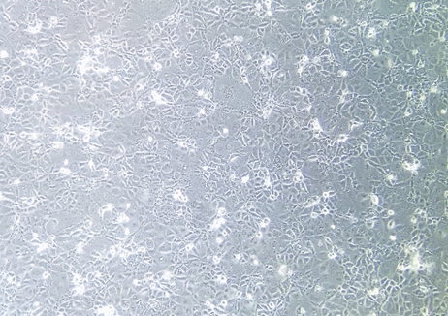
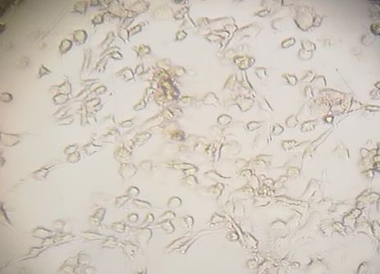
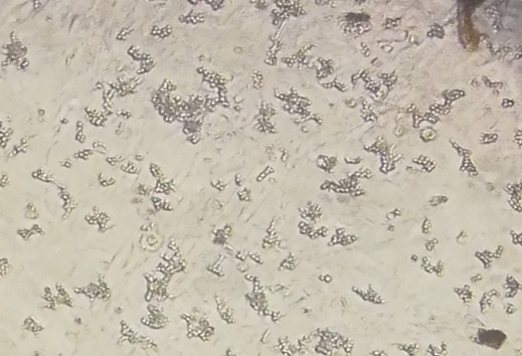
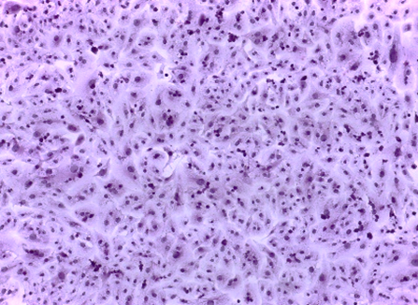
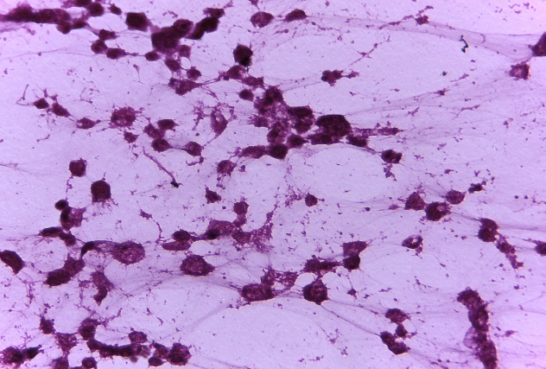
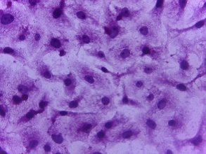
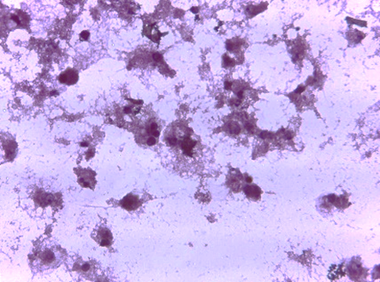
Oral mucosa
A
C
E
B1
B
D
F
MS.c. Ruqaya K.J

Slide 2
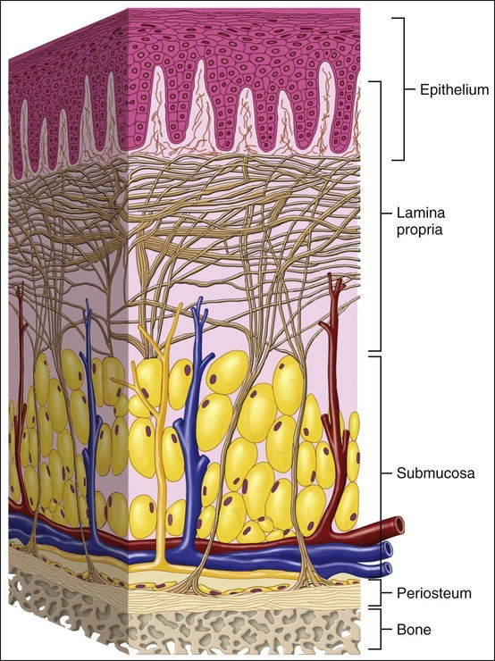
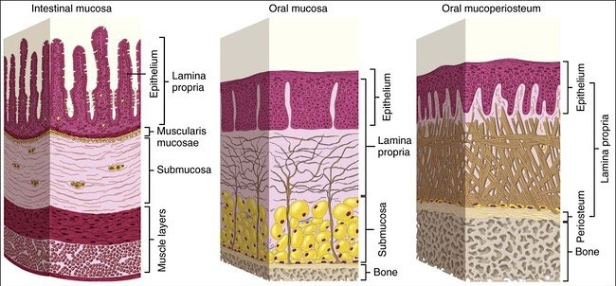
Oral mucosa
Term of the mucus membrane is used to describe the moist lining of GI tract, nasal passages and other body cavities that communicates with the exterior.
In the oral cavity, this lining is called as oral mucosa:
Stratiﬁed squamous epithelium (oral epithelium) + connective tissue (lamina propria)
The oral mucosa is located between the lips (continues with skin - bounded by vermilion border) & pharynx (continues with the rest of the gut).
Arvin Shahbazi D.M.D, Ph.D fellow

Slide 3
Functions of oral mucosa
Protection:
Surface lining (stratiﬁed squamous epithelium) separates & protects deeper tissues and organs.
Biting and chewing expose the oral soft tissues to mechanical forces (compression, stretching) and surface abrasions so the oral mucosa shows number of adaptions of the epithelium and the connective tissue to these mechanical forces.
The epithelium acts as a major barrier to the microorganisms and their toxic products which might cause infection.
Sensation:
Receptors for the temperature + pain (protopathic), touch, pressure. In the tongue also taste buds (taste receptors) are present.
Note: Reﬂexes like swallowing, salivating and gagging are initiated by the receptors of the oral cavity.
Secretion:
The major secretion associated with the oral mucosa is saliva, produced by the salivary glands. Sebaceous glands commonly are present in the oral mucosa, but their secretion are insigniﬁcant.
Thermal regulation:
In some animals (such as dog), the mucosa plays a major role in the regulation of the body temperature.
The human oral mucosa plays no practical role in regulation of body temperature and no obvious specializations of blood vessels exist for controlling heat transfer (such as arteriovenous shunts).
Arvin Shahbazi D.M.D, Ph.D fellow

Slide 4
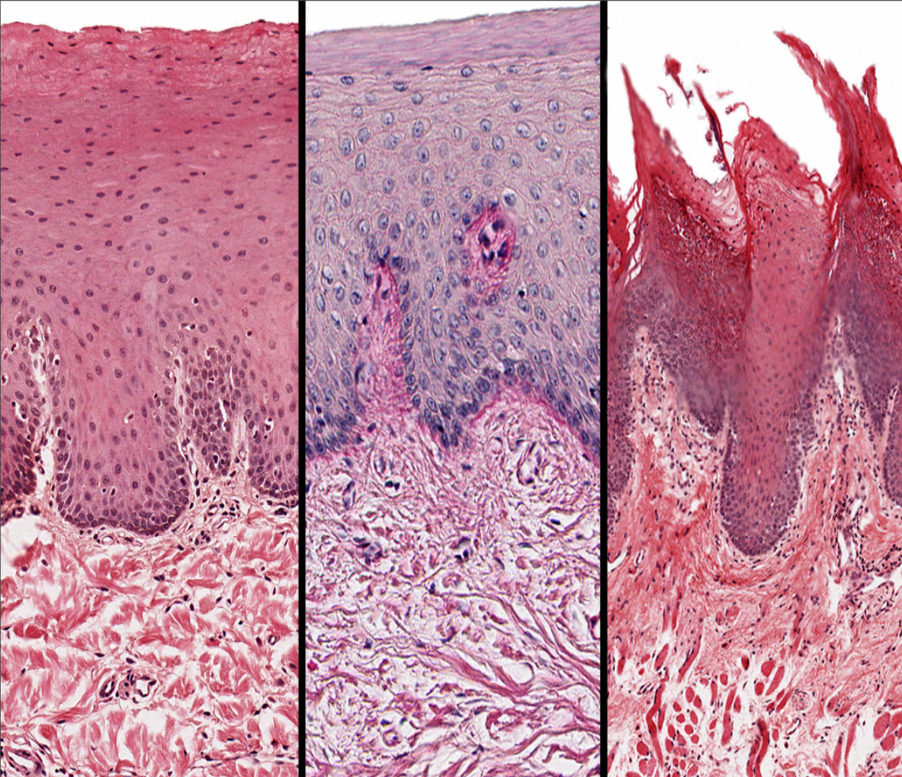
Types of the oral mucosa according to their primary functions
Lining mucosa
2. Masticatory mucosa
3.Specialized mucosa
Arvin Shahbazi D.M.D, Ph.D fellow

Slide 5
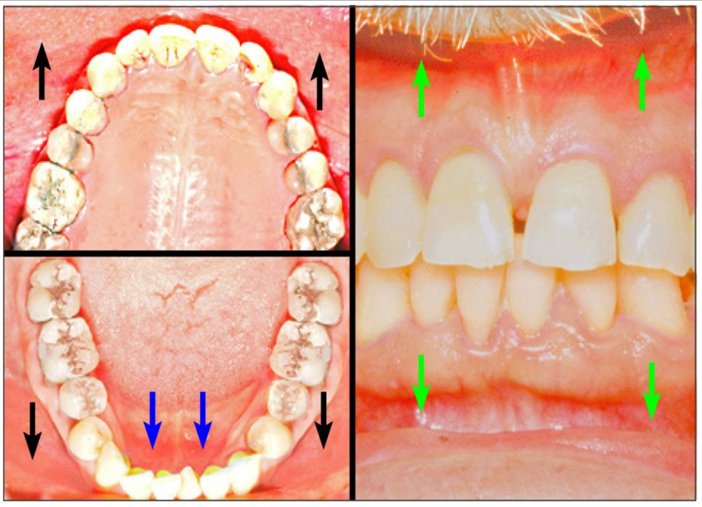
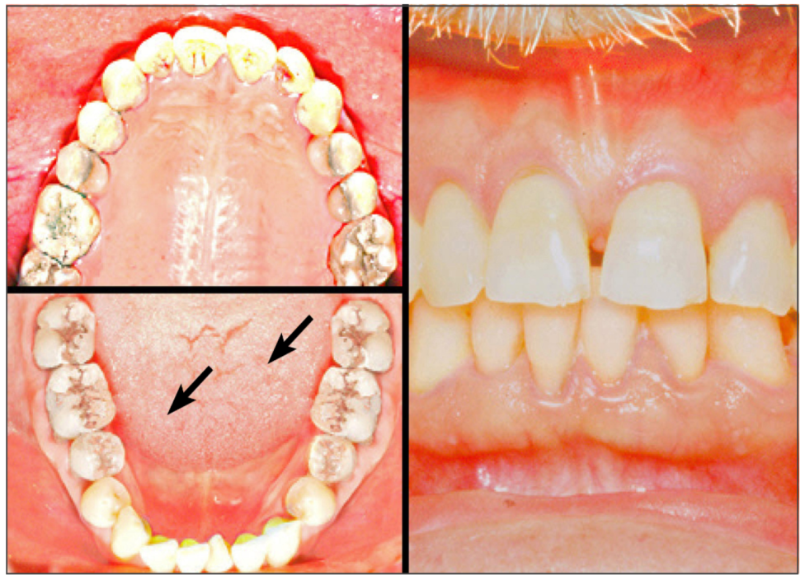
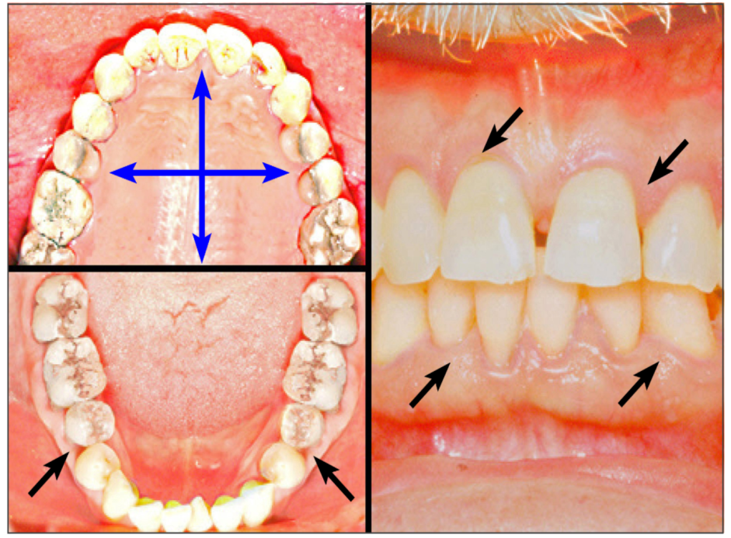
Lining mucosa
Specialized mucosa
Masticatory mucosa

Slide 6
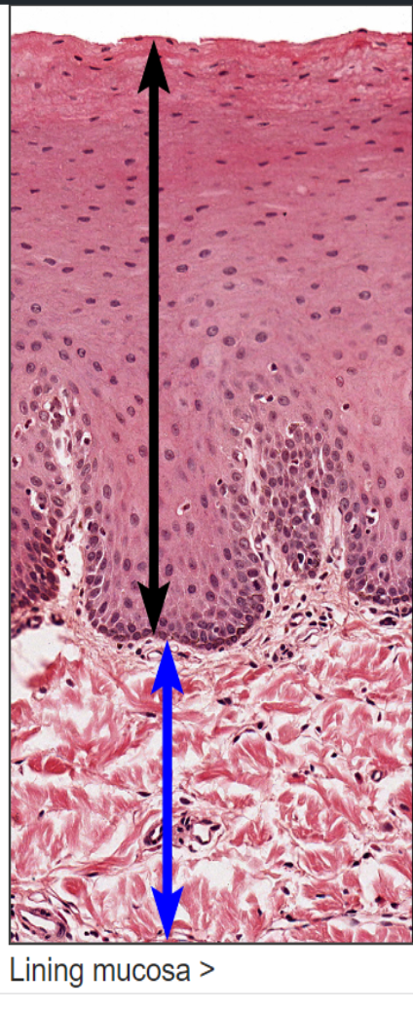
Lining mucosa
(forms 60% of the total oral mucosa):
Stratiﬁed squamous nonkeratinized epithelium, found on:
- Buccal mucosa (inner lining of the cheeks)
- Floor of the oral cavity
- Labial mucosa (inner lining of the lips)
- Alveolar mucosa (lining between the buccal and labial mucosae)
- Soft palate
- Underside the tongue

Slide 7
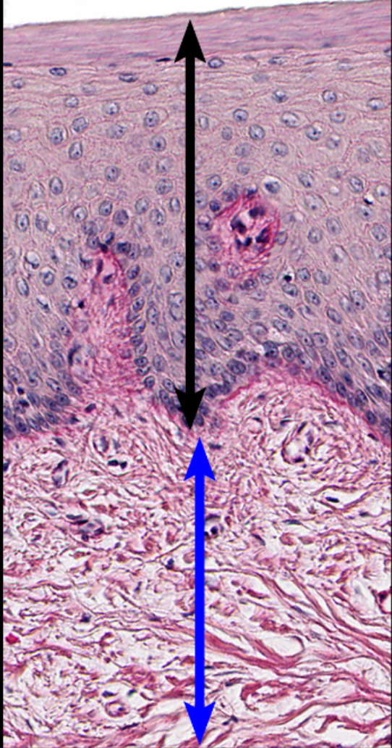
Masticatory mucosa
(forms 25% of the total oral mucosa):
Stratiﬁed squamous keratinized epithelium, found on:
- Dorsum of the tongue
- Hard palate
- Attached gingiva

Slide 8
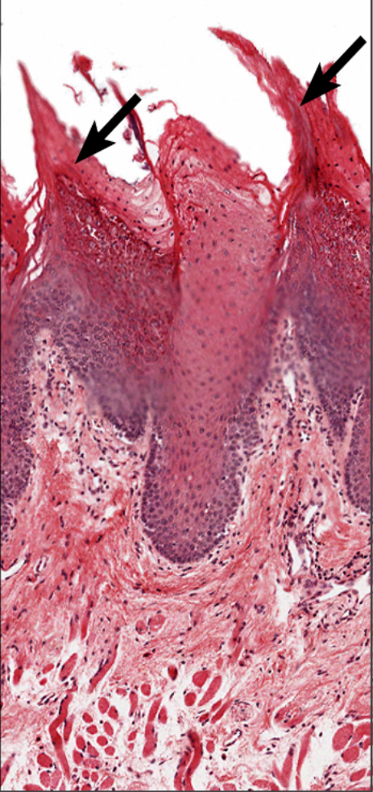
Specialized mucosa
(forms 15% of the total oral mucosa): Taste buds

Slide 9
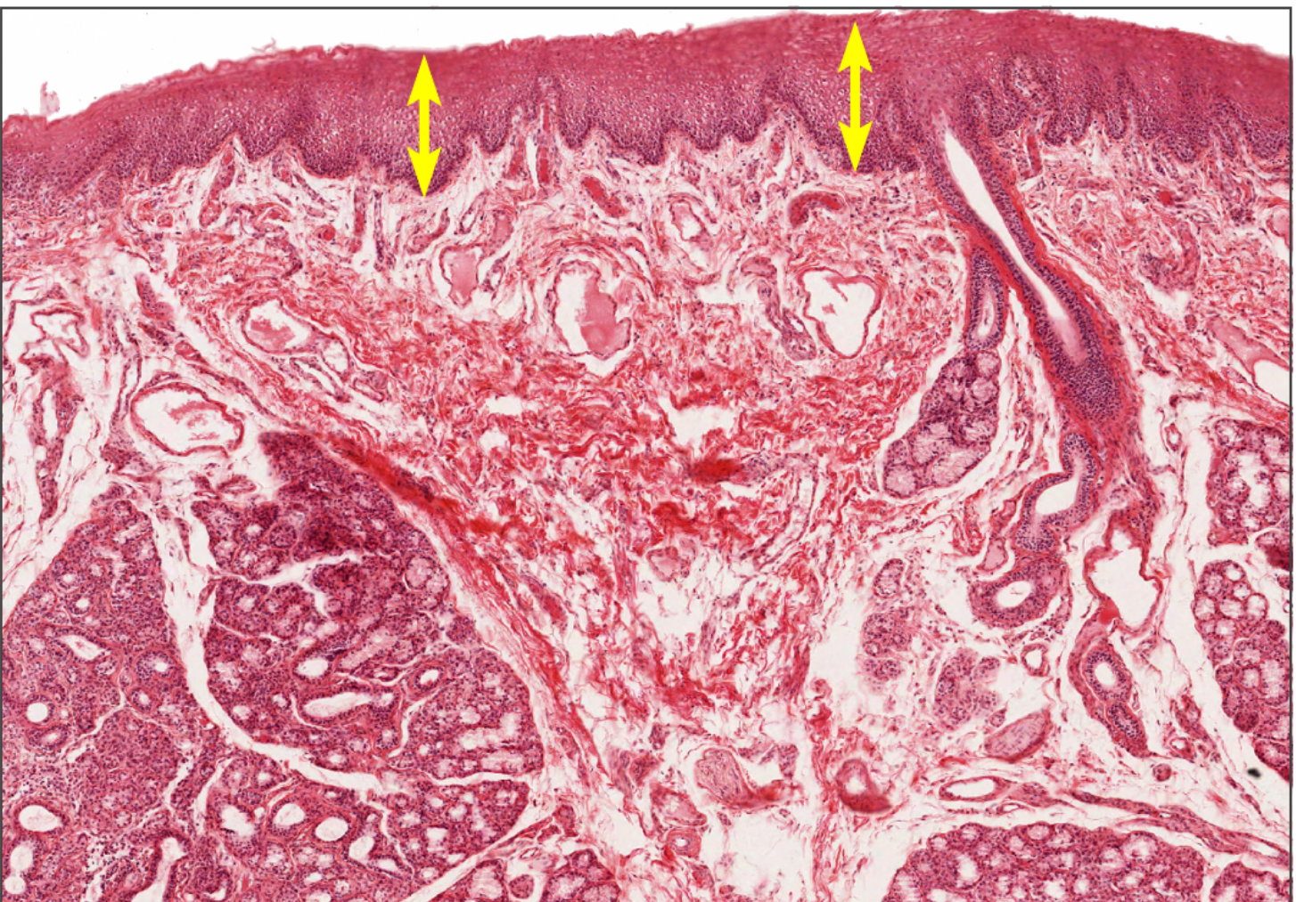
epithelium
Epilamina propria
submucosa
Lining mucosa lines all of the oral cavity except the gingiva, hard palate, and the dorsum of the tongue. It is composed of stratified squamous moist epithelium and its underlying lamina propria; a muscularis mucosae is lacking. A submucosa lies beneath the mucosa and usually contains the minor salivary glands (mixed glands). 100x

Slide 10
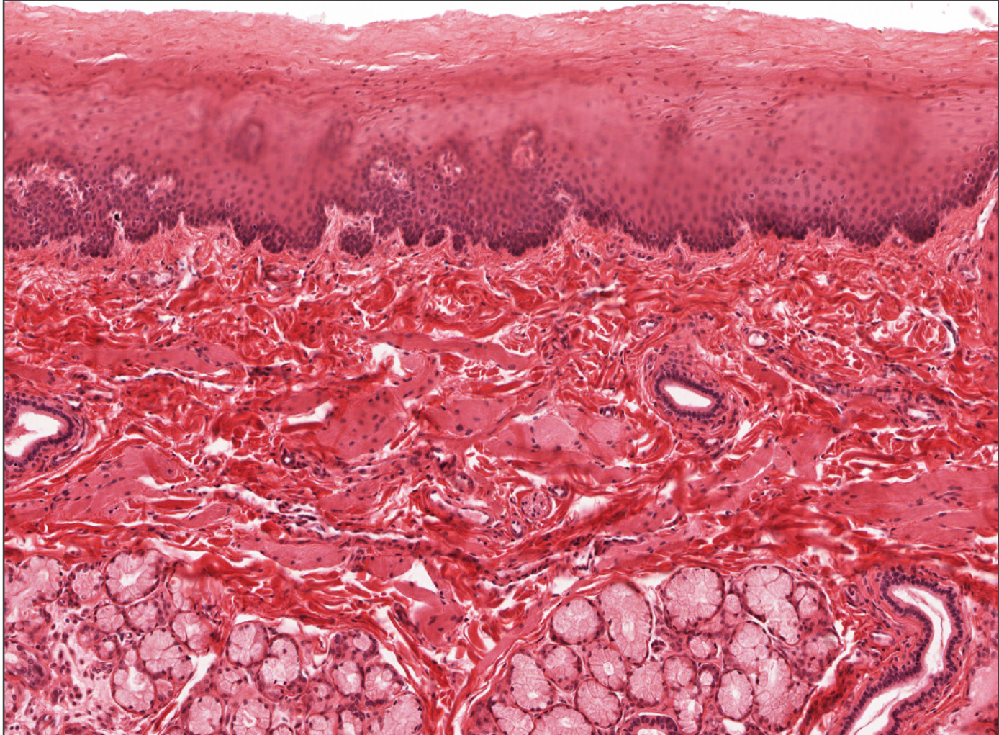
epithelium
Papillary layer of lamina propria
Epilamina propria
Lining mucosa
submucosa
Lining mucosa

Slide 11
Oral mucosa: Gingiva

Slide 12
The gingiva (commonly called the gums) is composed of the epithelia and connective tissue that surround and suppport the tooth. Subdivisions of the gingiva include masticatory mucosa covering its external surface, sulcular epithelium facing the gingival sulcus, and attachment epitheliun that attaches to the tooth. Fibers in the gingival lamina propria anchor the gingiva to the tooth and to the alveolar bone. 10x, 50x

Slide 13
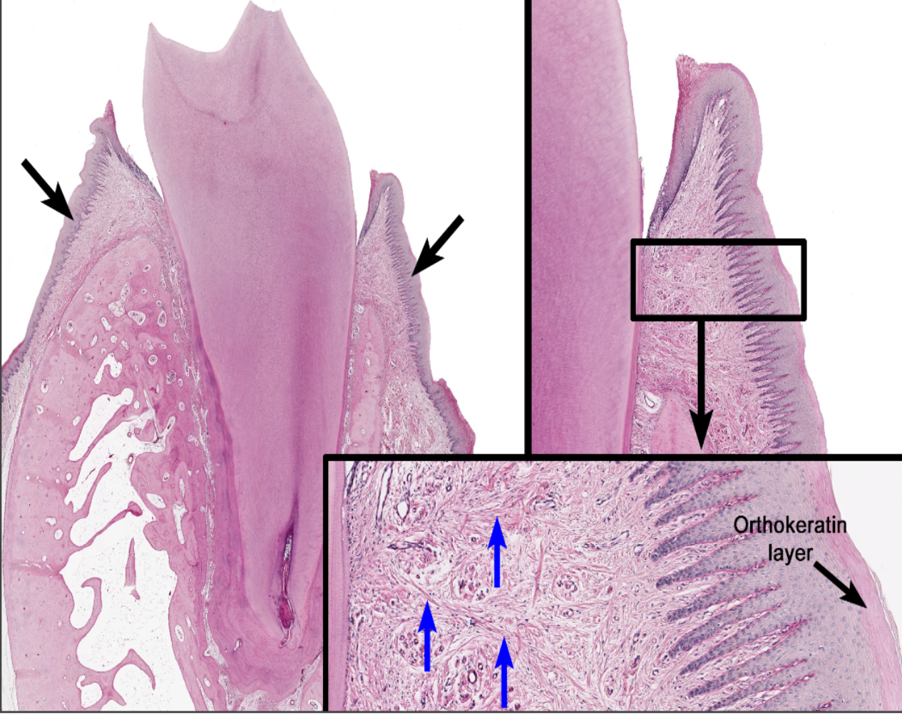
Masticatory mucosa covers the attached and free gingiva. It possesses a stratified squamous epithelium, either para- or orthokeratinized. The highly interdigitated rete ridges and connective tissue papillae firmly attach the epithelium to the lamina propria, which in turn is anchored to the tooth and the underlying alveolar bone by collagen fibers (blue arrows).

Slide 14
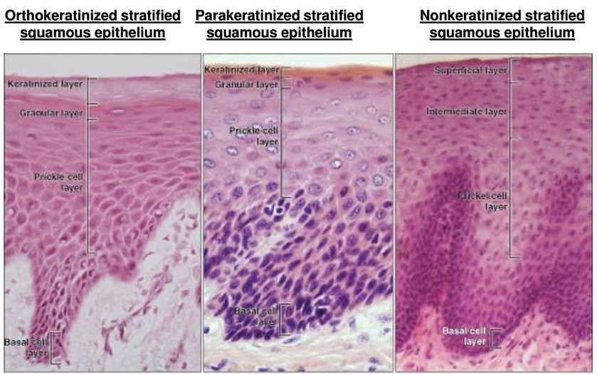
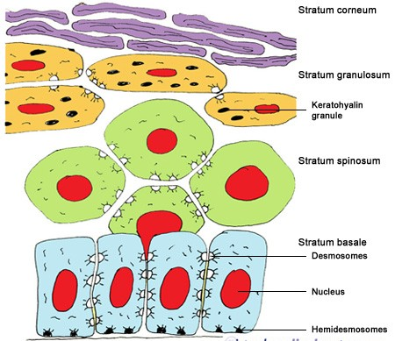
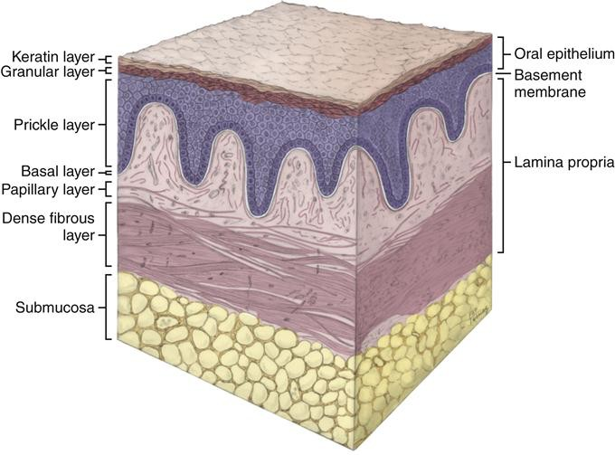
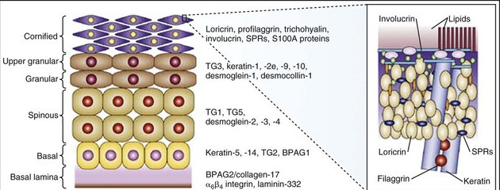

Slide 15
THANKS

